Slide 1




Soteria: Provable Defence against Privacy Leakage in Federated Learning from Representation Perspective
Sun, Jingwei, Ang Li, Binghui Wang, Huanrui Yang, Hai Li, and Yiran Chen. "Soteria: Provable defense against privacy leakage in federated learning from representation perspective." In Proceedings of the IEEE/CVF conference on computer vision and pattern recognition, pp. 9311-9319. 2021.
Guided by:
Prof. C Krishna Mohan
Presenter: Yash Shukla CS23MTECH14018
Teaching Assistant:
K Naveen Kumar
PhD Research Scholar

Slide 2
Index
Problem statement
Limitations
Motivation
Proposed defence
Datasets
Research gaps
Experimentation/results
Reproduced results
Novelty
Conclusion
References

Slide 3

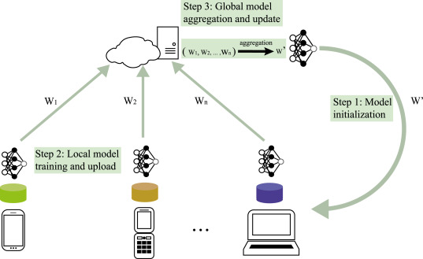
Problem statement
Current defence strategies have been presented to prevent privacy leakage like differential privacy, secure multi-party computation, and data compression.
But this approaches incur either significant computational overhead or unignorable accuracy loss.
Sharing model updates makes vulnerable to inference attacks like property inference attack and model inversion attack.
The essential cause of privacy leakage in FL, specifically concerning data representation leakage from model updates, has not been thoroughly explored.
Image Reference

Slide 4

Limitations (of previous work) and Motivation
Non-IID data characteristics exacerbate representation leakage, further compromising privacy.
Key observation is that the data representation leakage from gradients serves as the essential cause of privacy leakage in FL.
The class-wise data representations are embedded in shared local model updates, and such data representations can be inferred to perform model inversion attacks like DLG (Deep Leakage from Gradients) and GS(Gradient Similarity)
Therefore, the information can be severely leaked through the model updates.

Slide 5
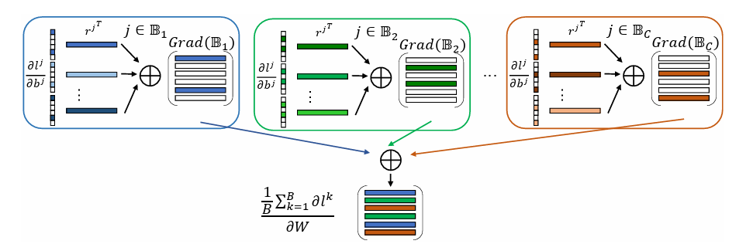

Limitations (of previous work) and Motivation (Contd.)
Data representations tend to be embedded in different rows of gradient(intuition behind the equation)
Gradient of the loss function (l) is calculated with respect to the weight matrix of the FC layer
Change in loss with respect to the output for each data sample in batch
Represents the gradient with respect to the data samples in Bi
Provides an overall gradients that indicates how the weights in the FC layer should be adjusted to minimize the loss function across the entire batch of data
Figure : Illustration of the gradient updates of class-wise data in a batch

Slide 6
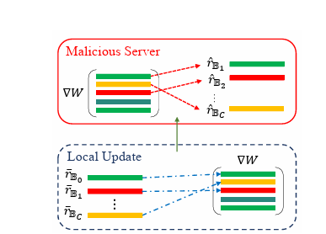
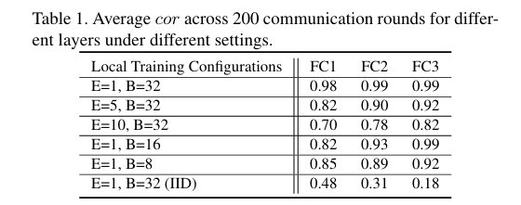
Limitations (of previous work) and Motivation(Contd.)
Embedded in gradients(Inferring the class-wise representations) :
Different classes have different representations, the information about representations gets reflected in different rows of the overall gradients.
Data stays more separate (less entangled in gradients) which is privacy concern ,because its easier for attacker to understand which datapoint belongs to which classes if they access gradients.
Colored bars represents the magnitude of values in gradients ,color-coded indicates different classes
Inferred Representation
True representation
Inferring the class-wise data representations :
Evaluation metric : Correlation co-efficient (cor) between true data representation and inferred representation for each class on each participating device.
Cor is much lower compared to non-IID settings. Because having more diverse data on each device makes representation harder to isolate.

Slide 7

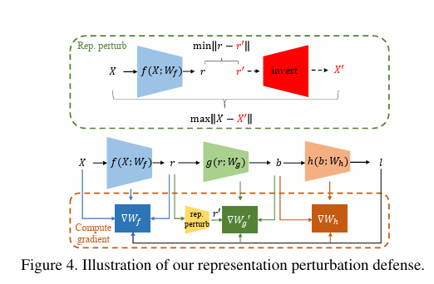
Proposed Defence method (Soteria)
Soteria aims to perturb the data representations in a specific layer with goals:
Reduce Privacy leakage : Perturbed Representations should make it difficult to reconstruct the original input data
Maintain Model performance : Perturbed Representations should remain similar to the original representation to avoid impacting model accuracy.
Formalization of Goals :
X : Raw Input Data
r’: Reconstructed Representation after Perturbation
r : Clean Data Representation (without Perturbation)
X’ : Reconstructed Input Data using the Perturbed Representation

Slide 8

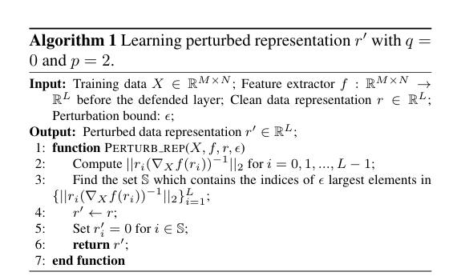

Proposed Defence method (Soteria)(Contd.)
Optimization problem : Finding optimal perturbed data representation (r’) that satisfies the two goals mentioned earlier.
Flow of Information : (X)(Original Data) → Feature Extractor(f) →
(Cleaned Representation)(r)
This Algorithm is Identifying the largest elements in a set derived
From the data representation & gradients. These elements are used
To create perturbed representations.
Lp Norms measures the distance between two points
(reconstructed input vs original input) larger norms – more
Information content.
P=2 : This corresponds to MSE between reconstructed & Original
Input,which defence aims to maximize (increase dissimilarity)
Q=0 : choice simplifies the solution & improves communication
efficiency
Objective :
Constraint :

Slide 9
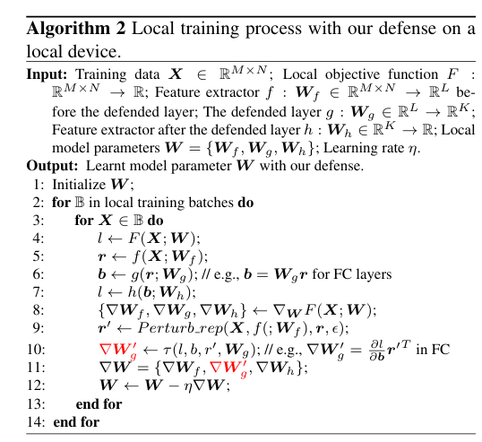
Proposed Defence method (Soteria)(Contd.)
This algorithm trains a local model on a device while incorporating a defence mechanism(g)
Calculates loss & feature representation
Calculates feature representation by applying feature extractor
Calculates output(b) of the defended layer by applying it to the feature representation(r)
Calculates feature representation(l) after defended layer (h) to the output (b) from the defended layer.
Computes the gradients of the loss function with respect to model parameters
Perturbing the feature representation and update model parameters.

Slide 10

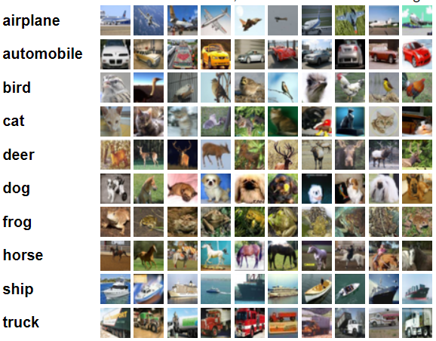
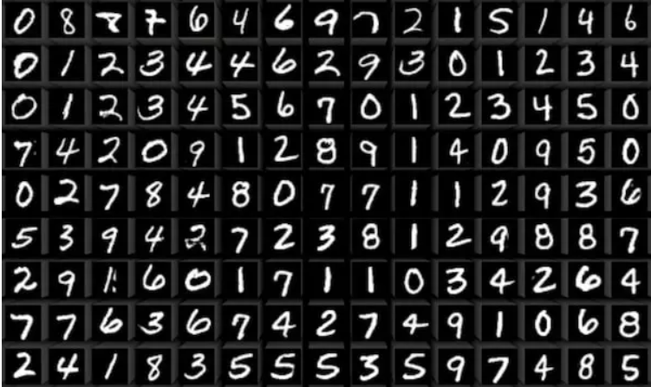
Dataset used
MNIST (Handwritten Digits)
CIFAR-10 : consist of 10 classes
Non – IID (Non – Independent & Identically Distributed) Distribution are created for both datasets, 100 devices and each device holds 2 Random Classes with 100 Samples

Slide 11
Research gaps
The paper's dataset may not sufficiently capture highly privacy-sensitive scenarios.
Exploring datasets with more sensitive information, such as facial or fingerprint data, could provide a more realistic assessment of privacy leakage risks.
Risk assessment, which assesses the level of risk to the privacy at every state during the attack.
Absence of adaptive response, limits the effectiveness of the proposed defence in different scenarios, where attackers are constantly evolving their strategies.

Slide 12

Experimentation/results
Attacks : Two different model inversion attacks
DLG (Deep Leakage from Gradients) : Aims to reconstruct devices’ data using their uploaded gradients.It optimizes reconstructed data to minimize the Euclidean distance as a measure of similarity between raw gradients and reconstructed.
GS ( Gradient Similarity ) : Similar to DLG ,It utilized cosine similarity between raw gradients and dummy gradients to optimize the reconstructed data.
Baseline defenses :
GC ( Gradient Compression ) : reduces the communication cost by discarding gradients with magnitudes below a certain threshold.
DP ( Differential Privacy ) : injects noise into gradients uploaded th the server to achieve a theoretical privacy guarantee.

Slide 13

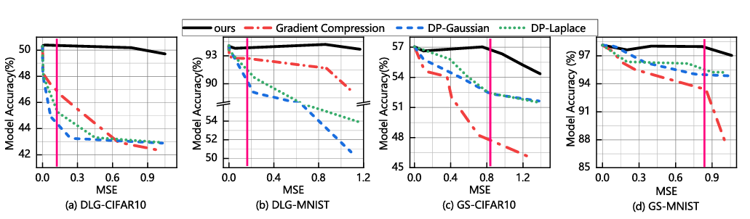
Experimentation/results
Utility and Privacy Trade-off :
MSE : Algorithm iterates over each pixel in both reconstruted image and raw image. Calculates pixel difference and averages the squared difference.
Lower MSE: implies the Reconstructed image is more similar to the Original Image,Hence High Risk of Privacy Leakage
Figure : Compared defenses on model accuracy and MSE between reconstructed image and raw image for different attack baselines and datasets. The pink vertical line is the boundary that there constructed image is unrecognizable by human eyes if MSE is higher.

Slide 14
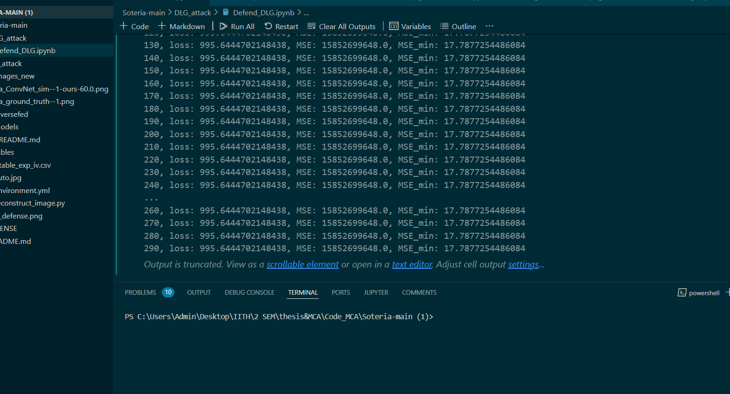
Experimentation/results
Accuracy = ( correctly classified data / total no of the data points ) * 100
A higher accuracy value signifies good utility.
A lower Accuracy value signifies that defence mechanism might be the impacting the model learning ability.
Goal is to find a defence mechanism that offers a good balance between privacy protection ( low MSE ) & Model Utility ( high Accuracy )
Figure : We can see clearly that strong perturbation might significantly reduce the MSE between the reconstructed and original image, making it harder to reconstruct the original data(better privacy). However, it might also significantly alter the data representation, potentially harming the model’s ability to learn effectively(low performance)

Slide 15
Configurations
Local Epoch 1
Batch size B as 32
Optimizer SGD
10 Devices sampled ramdomly
For DLG Attack, L – BFGS optimizer for 300 iterations with learning 0.01
For GS Attack, Adam optimizer for 120 iterations with learning rate 0.1
Purning rate 60%
Iterations 24,000
Figure : Compared defenses on model accuracy and MSE between reconstructed image and raw image for different attack baselines and datasets. The pink vertical line is the boundary that there constructed image is unrecognizable by human eyes if MSE is higher.

Slide 16
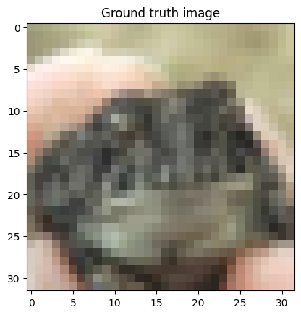
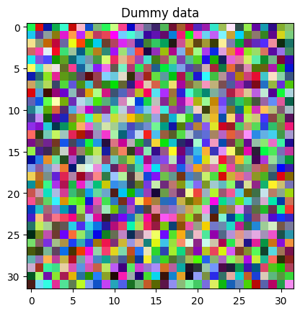
Results Produced :
Dummy data : Ground truth image :

Slide 17
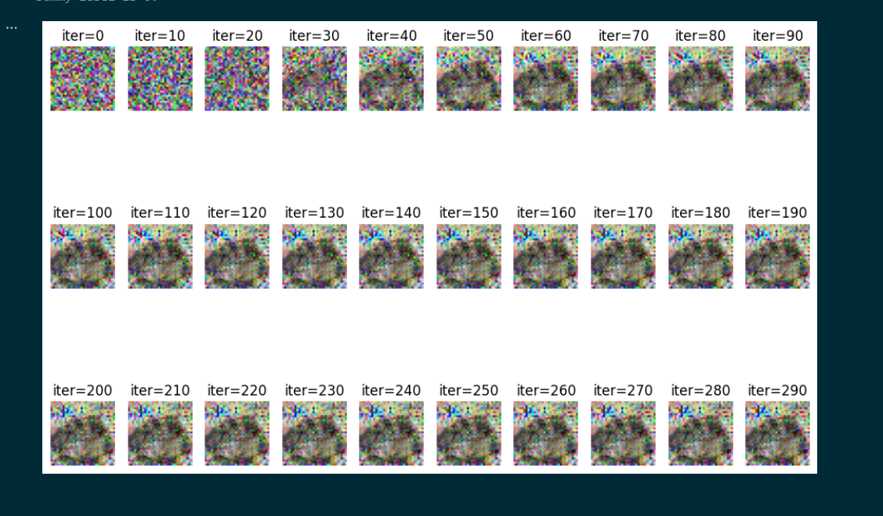
Results Produced :

Slide 18
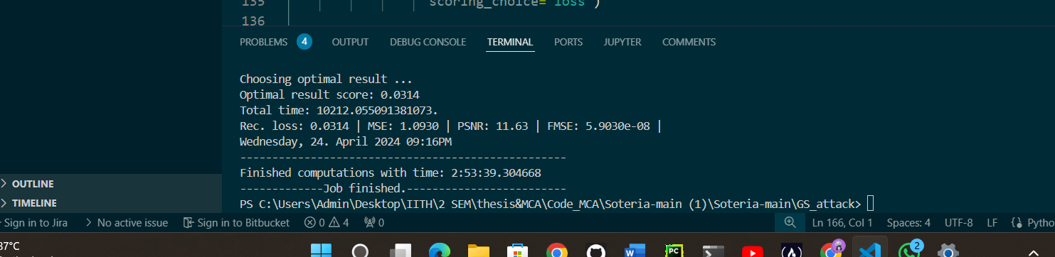
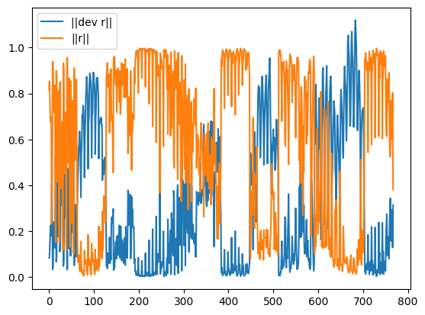
Results Produced :
For Gradient Similarity attack :
For DLG Attack :
|| r || - magnitude of tensor
||dev r|| - magnitude of deviation from the original image

Slide 19
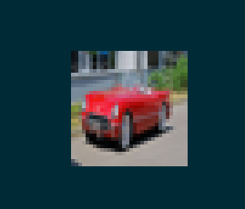
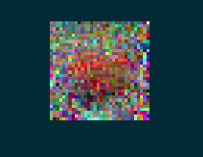
Results Produced :
Accuracy = ( correctly classified data / total no of the data points ) * 100
A higher accuracy value signifies good utility.
A lower Accuracy value signifies that defence mechanism might be the impacting the model learning ability.
Goal is to find a defence mechanism that offers a good balance between privacy protection ( low MSE ) & Model Utility ( high Accuracy )
Figure : Compared defenses on model accuracy and MSE between reconstructed image and raw image for different attack baselines and datasets. The pink vertical line is the boundary that there constructed image is unrecognizable by human eyes if MSE is higher.

Slide 20
Novelty
Investigating the impact of image reconstruction on classification accuracy, analysing how well the model performs after training on ground truth versus after training on reconstructed images.
This analysis helps determine if attackers could exploit the reconstructed images for malicious purposes.
Analysing gradients during training reveals how representations change over time, which can provide insights into the information flow within the network
Trying some super-resolution techniques to enhance the clarity of reconstructed images, based on that we can modify the defence mechanism.

Slide 21

Conclusion
Results demonstrate our defence is 160 times better than baseline defence.
Defence learned to perturb data representation in such a way that quality of the reconstructed data is severely degraded, while maintaining the performance.
Derived the robustness guarantee
Data representation is the essential cause of privacy leakage.
data representations are embedded in gradients.
Inferred class-wise data representations
Perturb the data representations with two goals : reducing the privacy leakage, maintain FL performance

Slide 22

References
Milad Nasr, Reza Shokri, and Amir Houmansadr. "Comprehensive privacy analysis of deep learning: Passive and active white-box inference attacks against centralized and federated learning." In 2019 IEEE Symposium on Security and Privacy (SP), 2019. 2
Zhibo Wang, Mengkai Song, Zhifei Zhang, Yang Song, Qian Wang, and Hairong Qi. "Beyond inferring class representatives: User-level privacy leakage from federated learning." In IEEE INFOCOM 2019-IEEE Conference on Computer Communications. IEEE, 2019. 1, 2, 3
Xiang Li, Kaixuan Huang, Wenhao Yang, Shusen Wang, and Zhihua Zhang. "On the convergence of fedavg on non-iid data" In International Conference on Learning Representations, 2019. 6, 8, 11, 12
Ligeng Zhu, Zhijian Liu, and Song Han. "Deep leakage from gradients" In Advances in Neural Information Processing Systems, 2019. 1, 2, 3, 4, 7
Matt Fredrikson, Somesh Jha, and Thomas Ristenpart. "Model inversion attacks that exploit confidence information and basic countermeasures." In Proceedings of the 22nd ACM SIGSAC Conference on Computer and Communications Security, 2015. 1, 2

Slide 23


Any Questions?

Slide 24
Thank you

